Slide 1

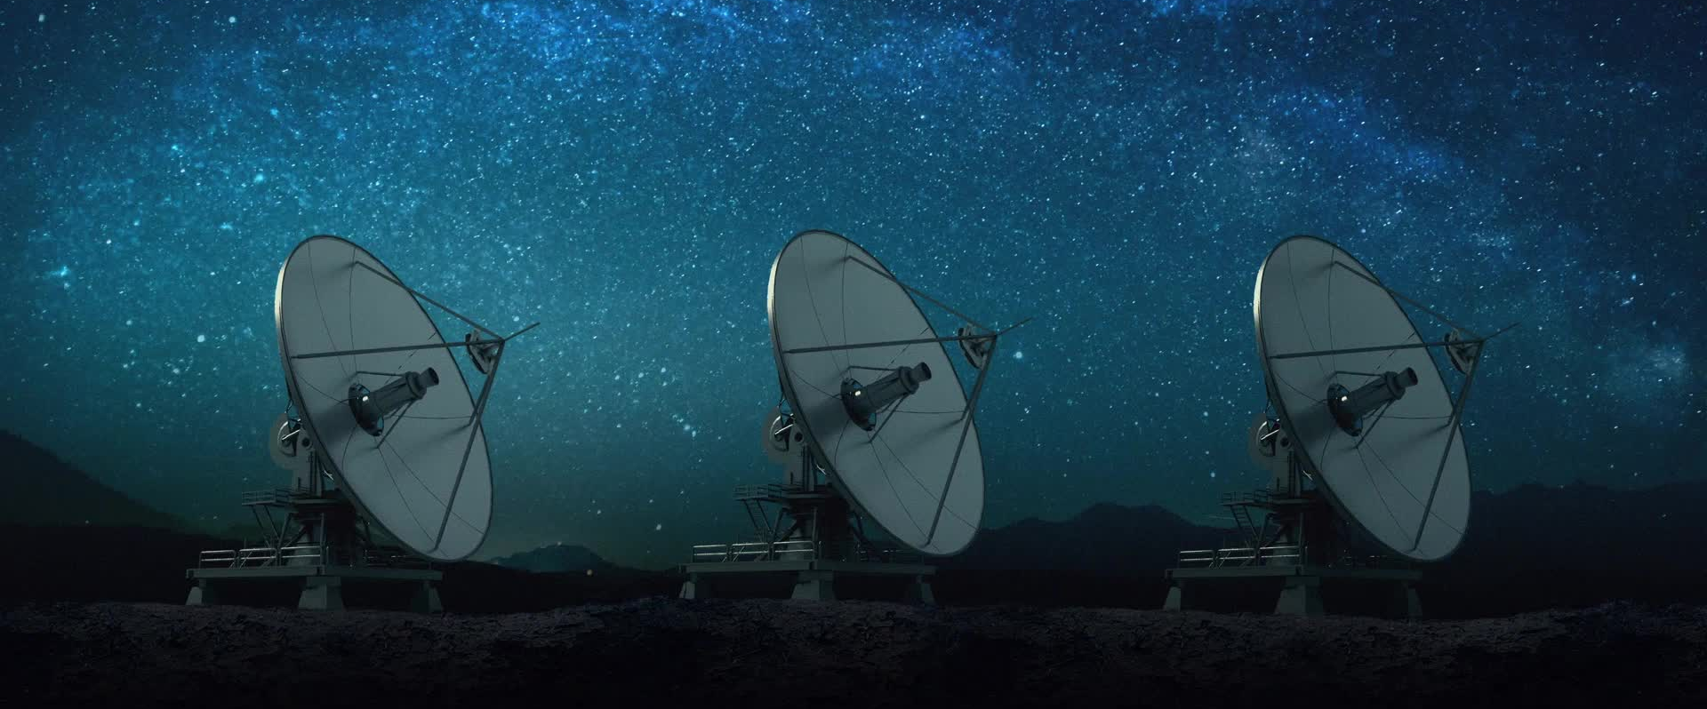
Earth Observation Project
Land Use / Land Cover (LULC) of Washington DC
Seyed Mohammad Moein Peyghambar Zadeh( 10921320)
May 2024

Slide 2
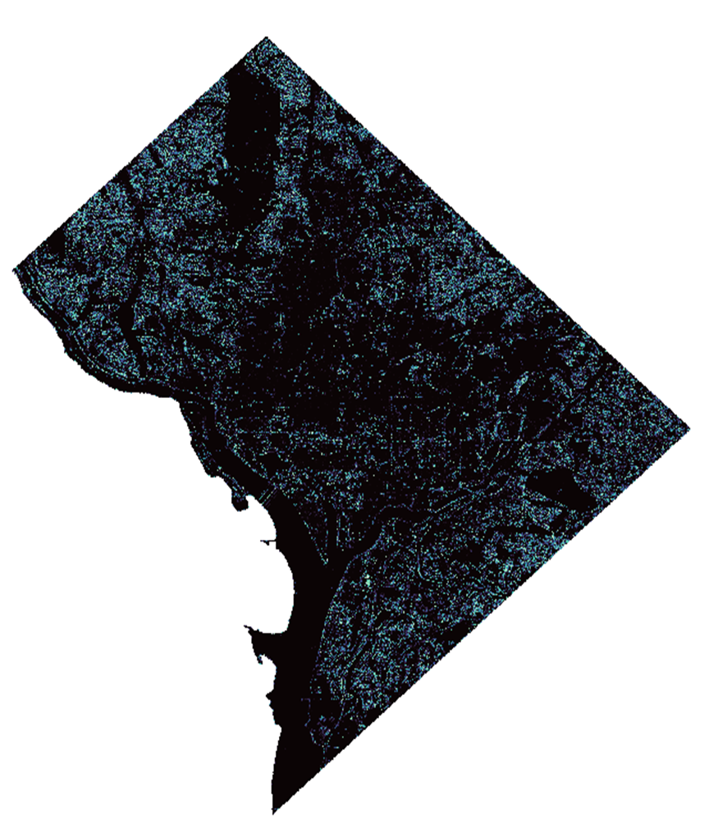
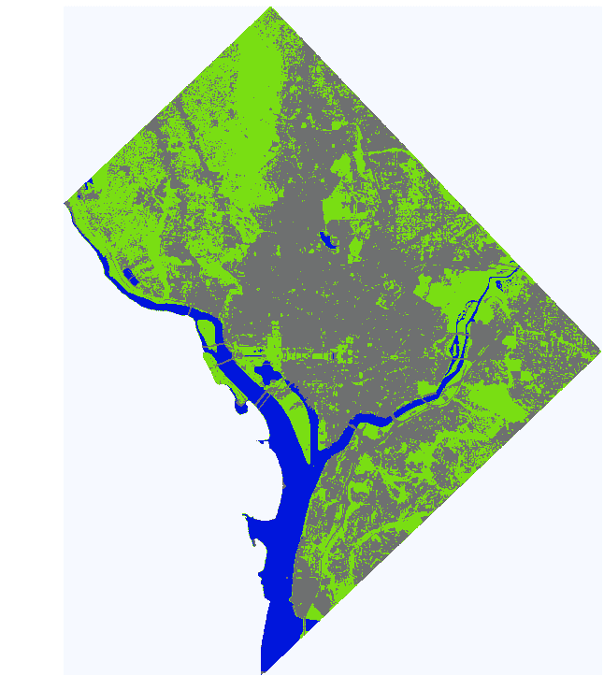
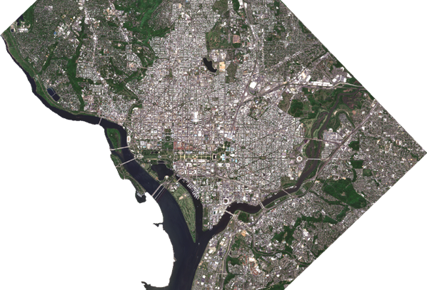
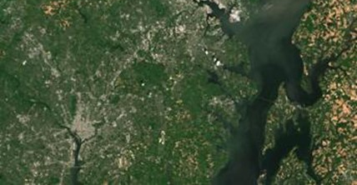
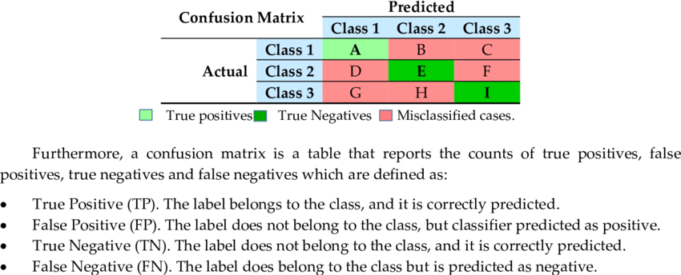
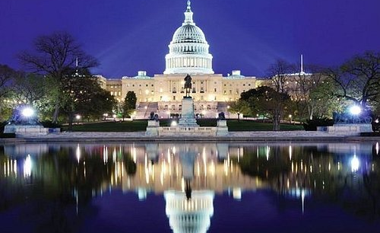
Accuracy Assessment
Classification Land Cover
Pre-processing and Visualization
Data Procurement and Import
Pre-processing and Visualization
Classification (Supervised and Unsupervised)
Data Procurement and Import
Introduction and Case study
Accuracy Assessment
Introduction and Case study

Slide 3
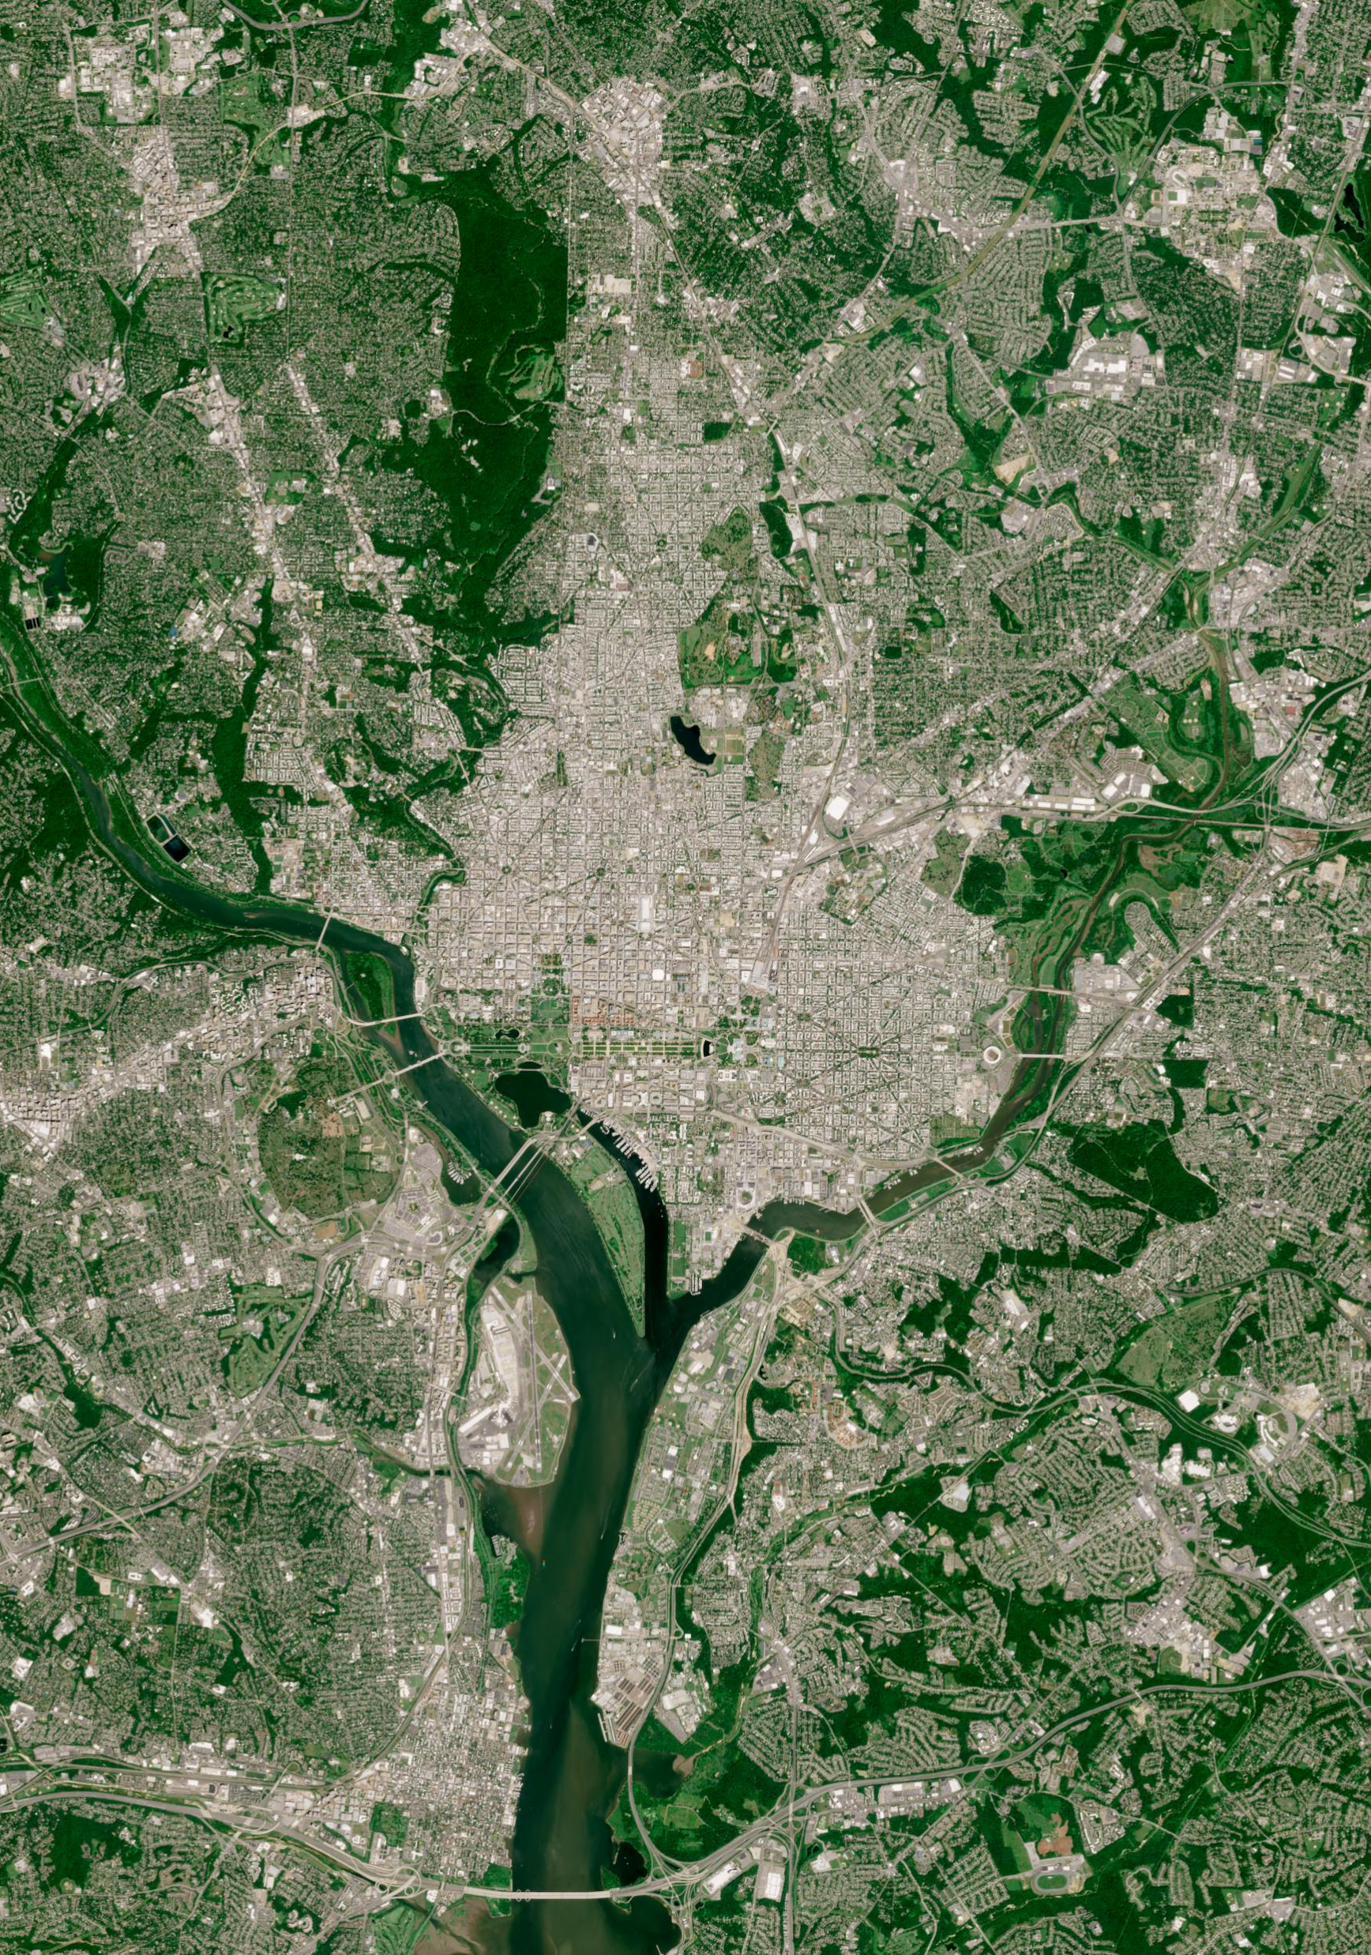
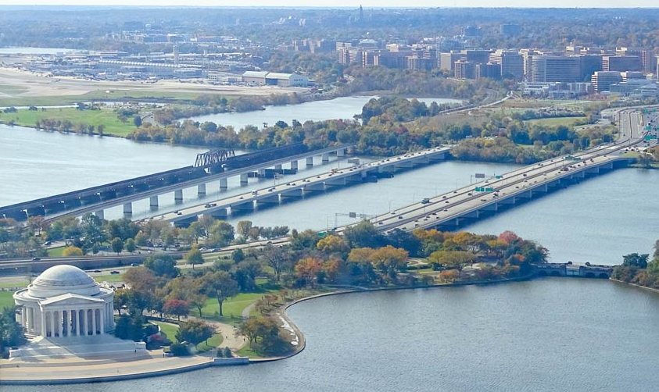
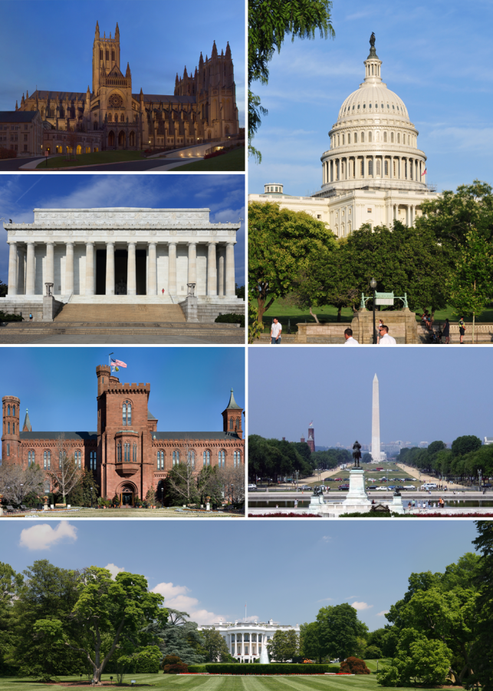
Case study – Washington, Dc
Introduction and Case study
The capital city is characterized by a diverse mix of land covers, including urban areas, parks, water bodies like the Potomac River, and significant historical sites and designated landmarks like the Capitol Building and The White House, roads and bridges like The Arlington Memorial Bridge.
Notes:
The study area is located in Washington D.C., the capital of the USA. This area has a mix of urban areas, parks, water bodies, and historical sites and landmarks. The diversity is high for different classes

Slide 4
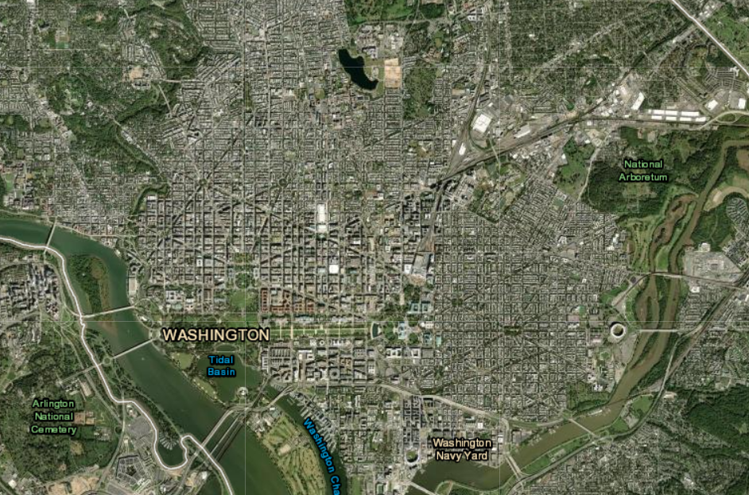
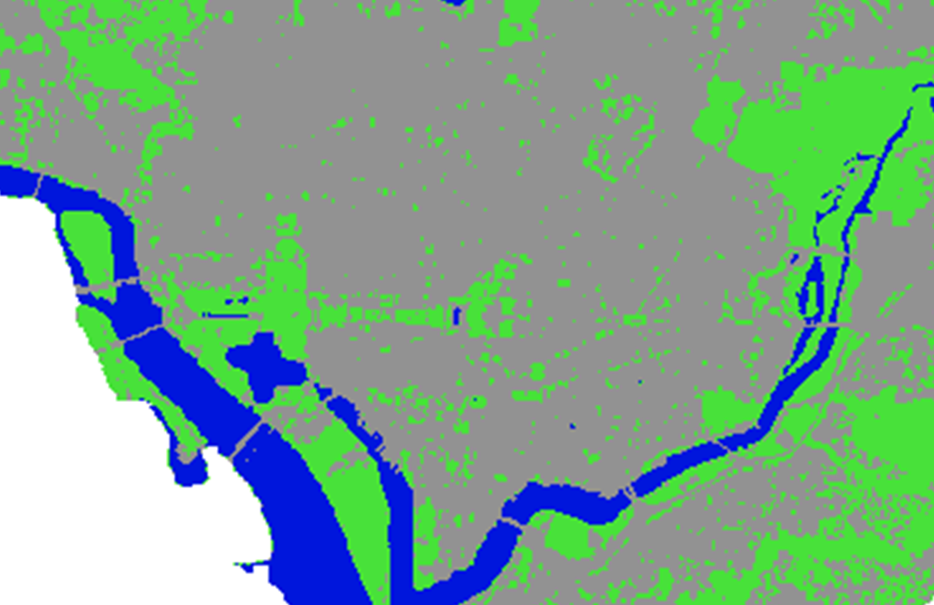
Washington, Dc
Introduction and Case study
During the past two decades, this region has experienced extensive land cover and land use changes due to substantial urban and suburban expansion resulting in many forested areas being taken over by residential, commercial, and industrial sites.
The findings are intended to support urban planning initiatives and environmental management strategies by providing data-driven insights into how land use has transformed in the nation's capital."
Notes:
The goal of this project is to map, analyze and understand these different land covers using satellite images and GIS tools. And after that we can use historical data to find out the changes. This will help in urban planning and environmental management.“
The objective of this presentation is to use multispectral satellite imagery to analyze and classify the diverse land cover types within Washington, D.C. This study aims to provide a detailed spatial understanding of the distribution and extent of various land covers such as urban infrastructure, vegetation, and water bodies.

Slide 5

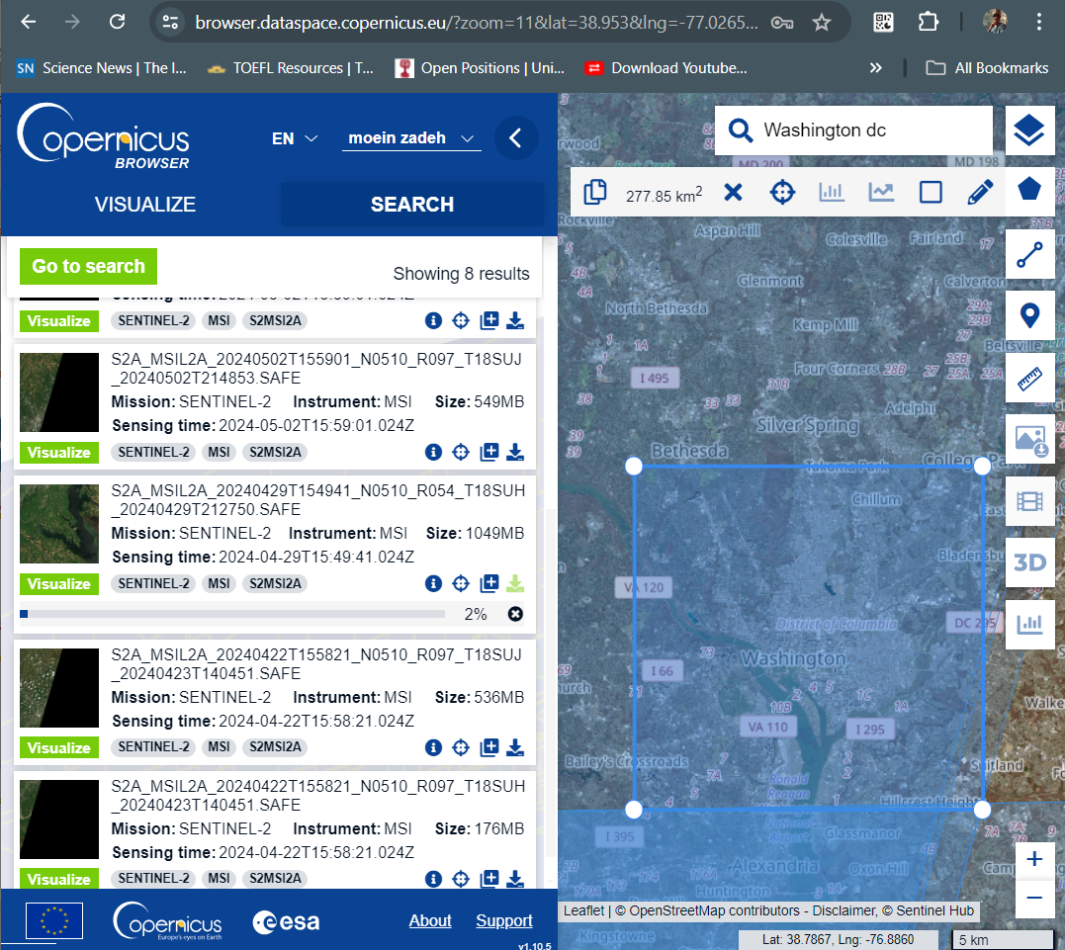
Data Procurement
Data Procurement and Import
Acquiring Sentinel-2 Level-2A Data:
Platform: Using the Copernicus browser to download Sentinel-2 Level-2A imagery.
Search Criteria: Setting the area of interest Washington, D.C. Specifying the time period for which we need the data.
Ensuring we select images with minimal cloud cover
Notes:
I got Sentinel-2 Level-2A satellite images from the Copernicus browser. We focused on Washington D.C., selecting images with clear skies to get the best data."

Slide 6

Platform and Import Data
Data Procurement and Import
Loading Data into QGIS:
Starting QGIS and create a new project.
1
Importing Imagery:
Layer > Add Layer > Add Raster Layer.
2
Browse to where we have saved our downloaded Sentinel-2 data and select the relevant .jp2 files that represent the spectral bands we intend to use for the classification.
3
Notes:
I loaded the data into QGIS. creating a new project and added the satellite image. The image include various spectral bands like Blue, Green, Red, and Near-Infrared, which are useful for classification."

Slide 7
Define the Band set
Pre-processing and Visualization
Sentinel-2 Bands | Resolution [meters]
Band 2 - Blue | 10
Band 3 - Green | 10
Band 4 - Red | 10
Band 5 - Vegetation Red Edge | 20
Band 6 - Vegetation Red Edge | 20
Band 7 - Vegetation Red Edge | 20
Band 8 - NIR | 10
Band 8A - Vegetation Red Edge | 20
Band 11 - SWIR | 20
Band 12 - SWIR | 20
Using a subset of Sentinel-2 Satellite image and using the bands illustrated in the following table.
Notes:
In this work I use 10 bands here in the table, (resampling algorithm and knn or bilinear methods to overcome with different resolution.

Slide 8
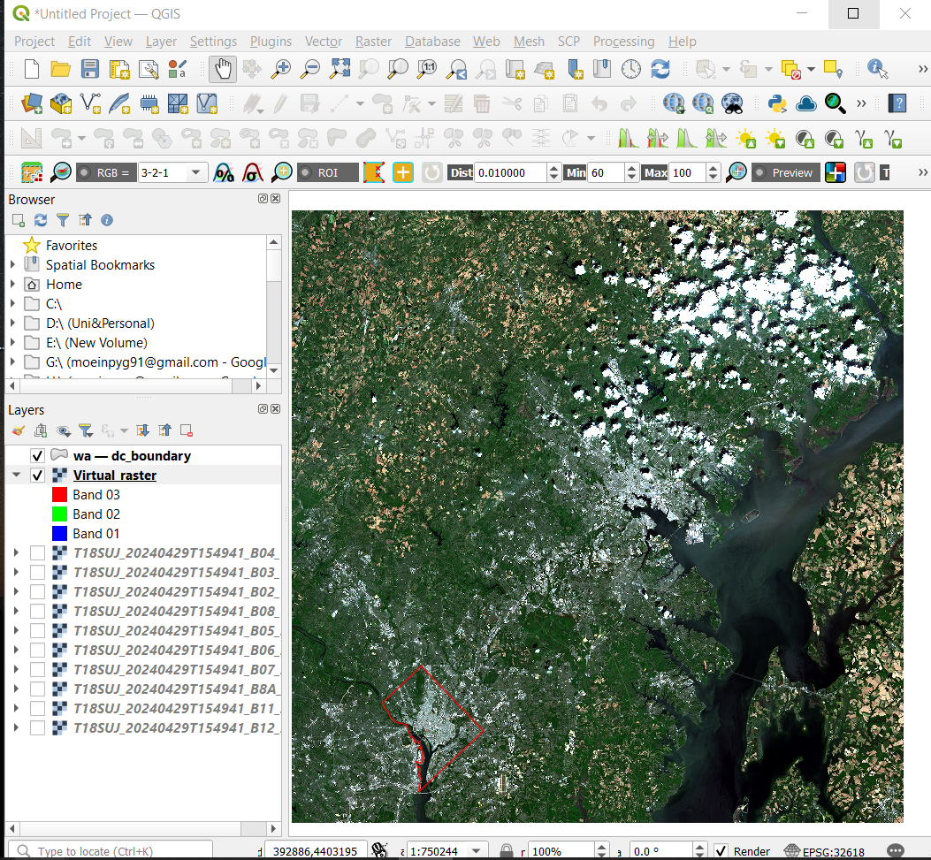
Image Exploration and Setup
Pre-processing and Visualization
Layer Stacking and Bandset
Virtual Raster: To simplify handling, creating a Virtual Raster that combines the required spectral bands.
Using Raster > Miscellaneous > Build Virtual Raster in QGIS. Include bands typically useful for our studies.
Typical band set for land remote sensing applications on Sentinel-2: B 2,3,4,5,6,7,8,8a,11,12
Clip
Cropping the area of Washington, DC using bounding box we downloaded from the official website.
Notes:
I combined the spectral bands into a Virtual Raster in QGIS. We then cropped the images to focus on Washington D.C.“ Cropping: Using bounding box for Washington D.C.

Slide 9

Pre-processing and Visualization
land cover classification categories
Water Bodies
Rivers and Streams
Lakes and Ponds
Pools
Vegetation and Parkland
Deciduous Forest
Evergreen Forest
Mixed Forest
Grassland
Wetlands
Built-up (Urban)
Residential Areas
Commercial and Industrial Areas
Transportation and Roads
Mixed Urban
Vacant Land
Notes:
I categorized different types of land cover, Here I used three classes water bodies, vegetation, and urban areas. I used color-coded maps to show the distribution of these categories."

Slide 10
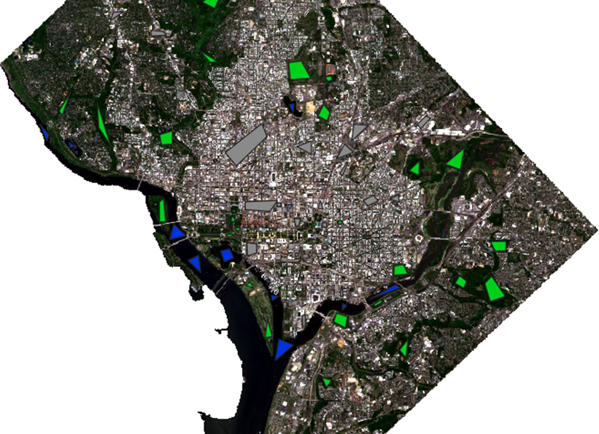
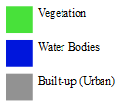
Pre-processing and Visualization
Train and test Sampling
Gray Area: The gray-shaded regions on the map are the built-up and urban area
Green Areas: On the other hand, the green-shaded areas represent the Forest, Vegetation and Parkland.
Blue Area: Blue area represent Rivers, Streams, Lakes, Ponds and Pools.
Notes:
The next one is to generate sampling data for test and train, here you can see sampling area of the 3 classes.

Slide 11
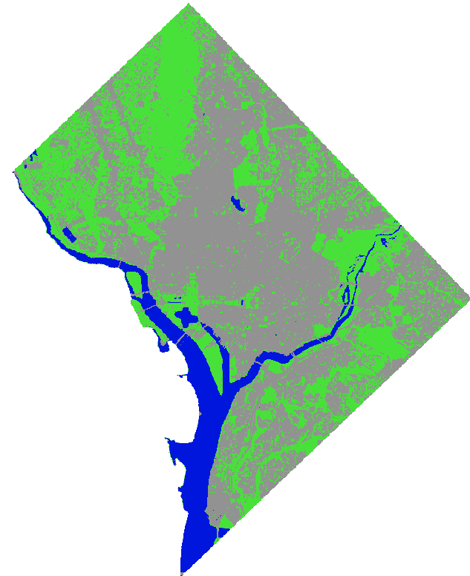
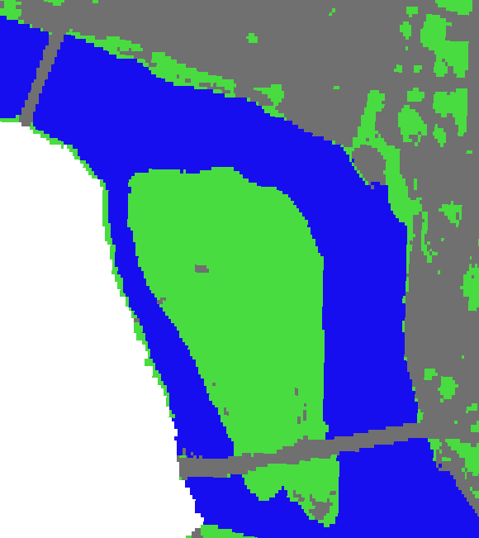
Supervised Classification
Classification (Supervised)
Dzetsaka plugin
Random Forest
Using ROIs as sampling areas
Train:70% / Test: 30%
Notes:
I used two classification methods: supervised and unsupervised. Using dzetsaka plugins For supervised classification, I used the Random Forest algorithm with training and testing data. to train and analyze data I use one hold cross validation seventy percent for train and thirty percent for test.

Slide 12
Accuracy Assessment
Truth Classified | Water | Vegetation | Built-up(Urban) | SUM
Water | 5877 99.96% | 1 | 0 | 5878 99.98% 0.02%
Vegetation | 2 | 6630 99.86% | 11 | 6643 99.80% 0.20%
Built-up(Urban) | 0 | 8 | 5902 99.81% | 5910 99.86% 0.14%
SUM | 5879 99.97% 0.03% | 6639 99.86% 0.14% | 5913 99.81% 0.19% | 18409 / 18431 99.88% 0.12%
Accuracy Assessment
Confusion Matrix
Notes:
I analyzed the result of the classification using a confusion matrix.

Slide 13
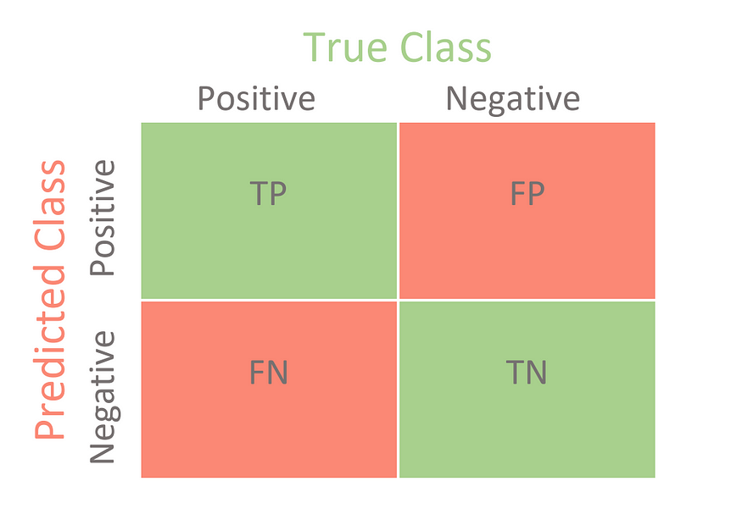
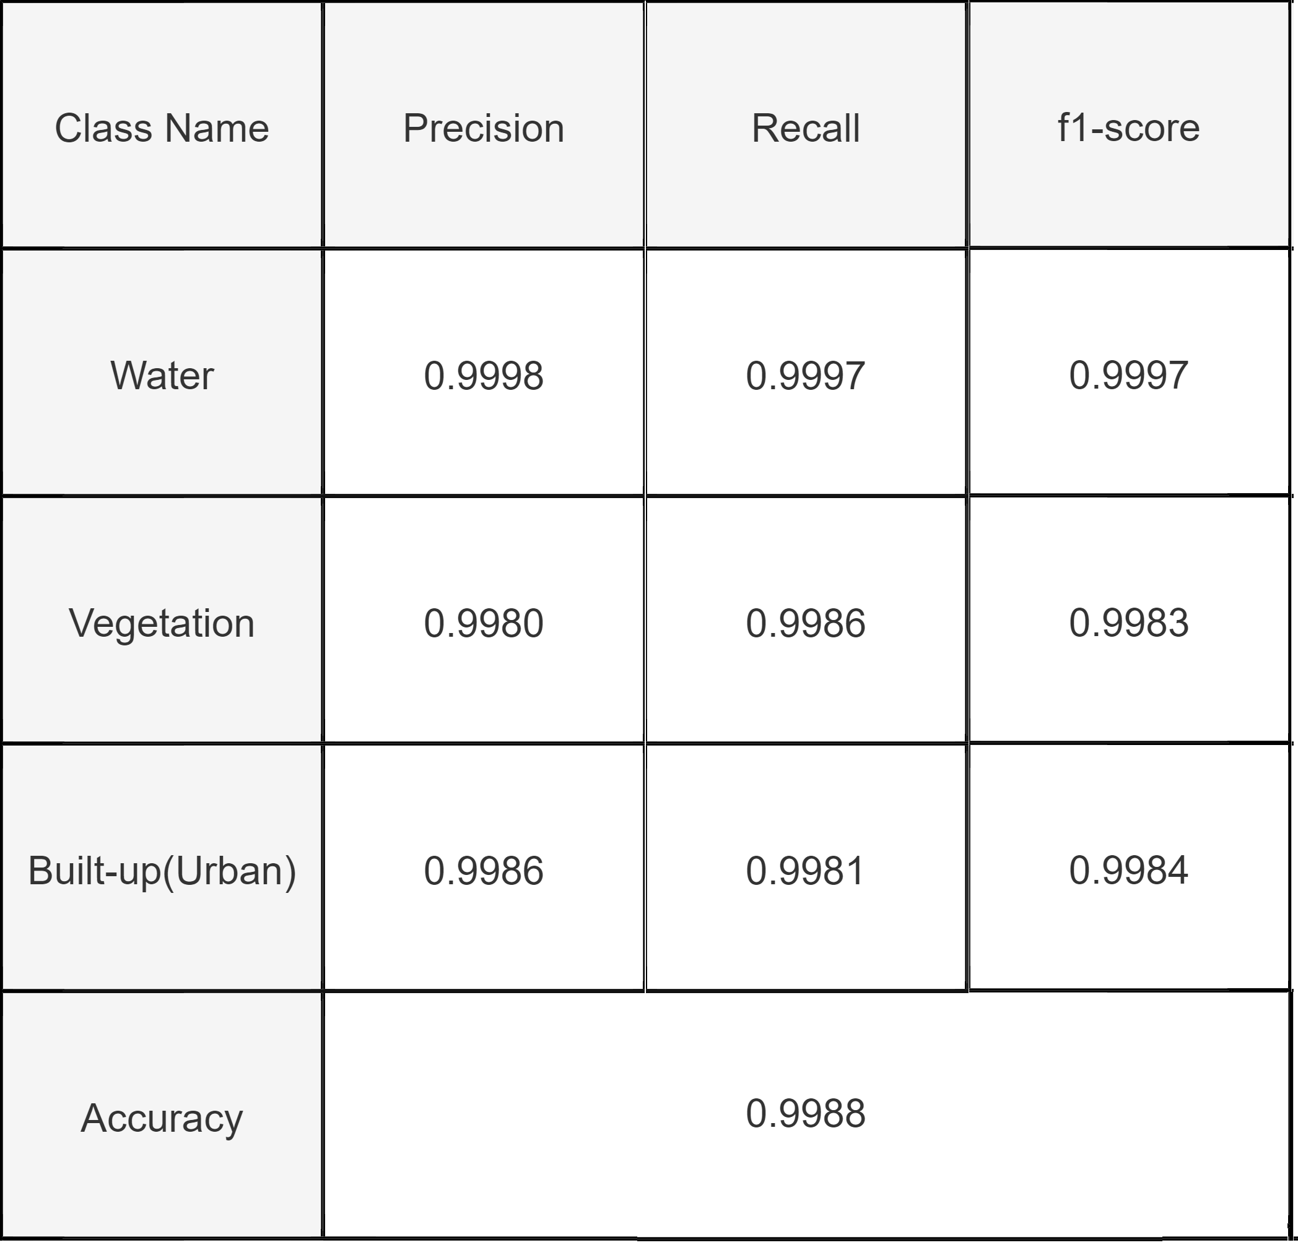
Key Metrics Summary
Accuracy Assessment
Precision = $\frac{TP}{(TP + FP) }$
Precision = TP/((TP + FP) )
Recall = $\frac{TP}{(TP + FN) }$
Recall = TP/((TP + FN) )
F1 Score = $\frac{2×Precision×Recall}{Precision + Recall}$
F1 Score = (2×Precision×Recall)/(Precision + Recall)
Notes:
This helps us understand how well our model performed by calculating metrics like Precision, Recall, and F1-score.“
True Positive (TP): It refers to the number of predictions where the classifier correctly predicts the positive class as positive.
True Negative (TN): It refers to the number of predictions where the classifier correctly predicts the negative class as negative.
False Positive (FP): It refers to the number of predictions where the classifier incorrectly predicts the negative class as positive.
False Negative (FN): It refers to the number of predictions where the classifier incorrectly predicts the positive class as negative.
Precision: It tells us what fraction of predictions as a positive class were actually positive. To calculate precision, use the following formula: TP/(TP+FP).
Recall: It tells you what fraction of all positive samples were correctly predicted as positive by the classifier. It is also known as True Positive Rate (TPR), Sensitivity, Probability of Detection. To calculate Recall, use the following formula: TP/(TP+FN).
F1-score: It combines precision and recall into a single measure. Mathematically it’s the harmonic mean of precision and recall.

Slide 14
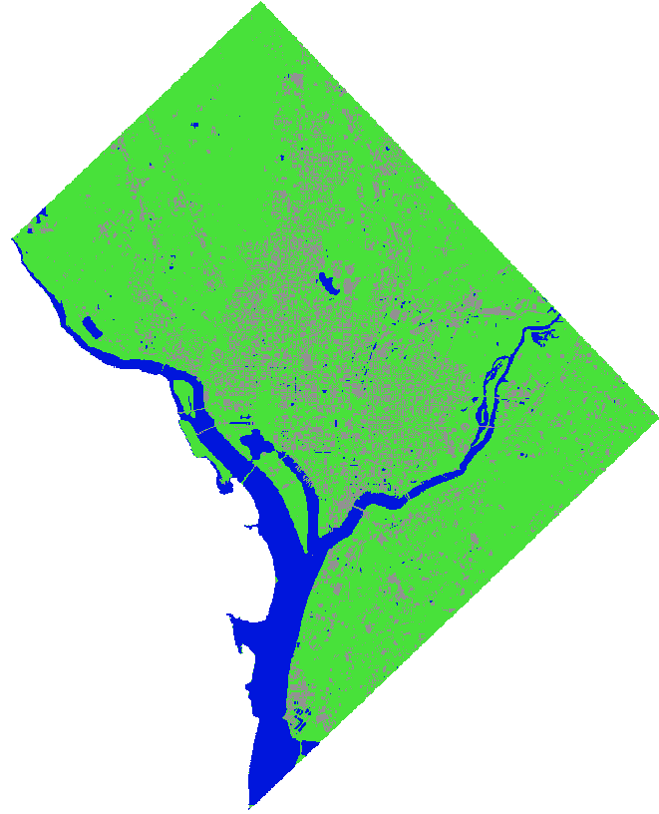
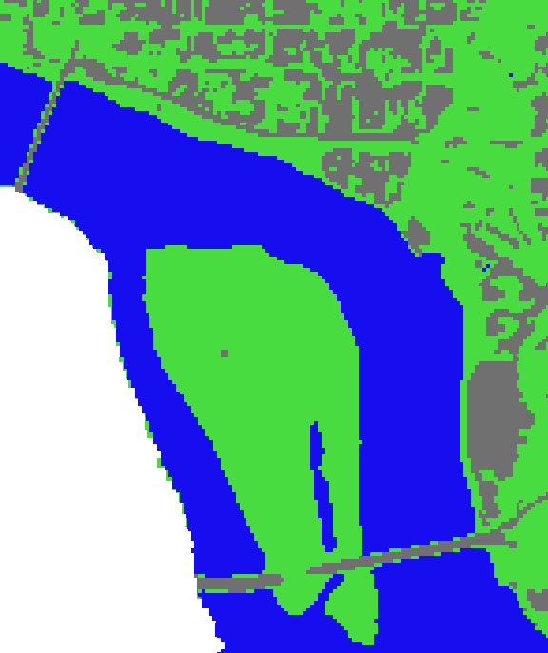
Unsupervised Classification
Classification (Unsupervised)
K-means
3 classes
Maximum 1000 iteration
Class Name | Precision | Recall | f1-score
Class1(Water) | 0.9993 | 0.9709 | 0.9849
Class2(Veg) | 0.9888 | 0.7446 | 0.8495
Class3(Urban) | 0.6095 | 0.9951 | 0.7560
Accuracy | 0.8565
Notes:
For unsupervised classification using OTB plugins, I used the K-means algorithm to classify the data.“ Here you can see that the unsupervised have the worst result wrt supervised classification, it is because of the type of data used. Supervised learning uses labeled training data, and unsupervised learning does not.

Slide 15

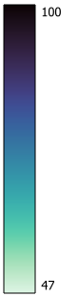
Confidence Map
Accuracy Assessment
High Confidence Areas: Areas where the map shows high confidence suggest that the classification algorithm is very certain about the class assignment. High confidence areas are generally reliable and require less scrutiny or validation, allowing analysts to focus efforts on more uncertain areas.
Low Confidence Areas: Low confidence values indicate uncertainty or ambiguity in classification. This could be due to several factors such as mixed pixels, similar spectral signatures between classes, or poor quality of training data.
Refinement of Classification: Analyzing confidence maps can help refine classification algorithms and training data. For example, areas of consistent low confidence might indicate that additional spectral bands, better quality images, or more representative training samples are needed.
Notes:
Here is the confidence map of the area for Random forest… the probability or likelihood of a pixel belonging to a particular class based on the spectral signature and the training data. These are often represented as grayscale or color-coded images where darker or more intense colors might indicate higher confidence.
These areas might need further investigation. Ground truthing, additional training samples, or adjustments in the classification parameters might be necessary to improve confidence.

Slide 16
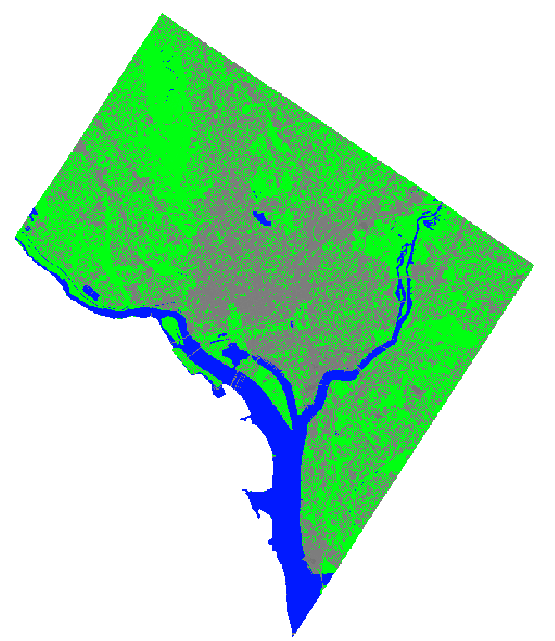
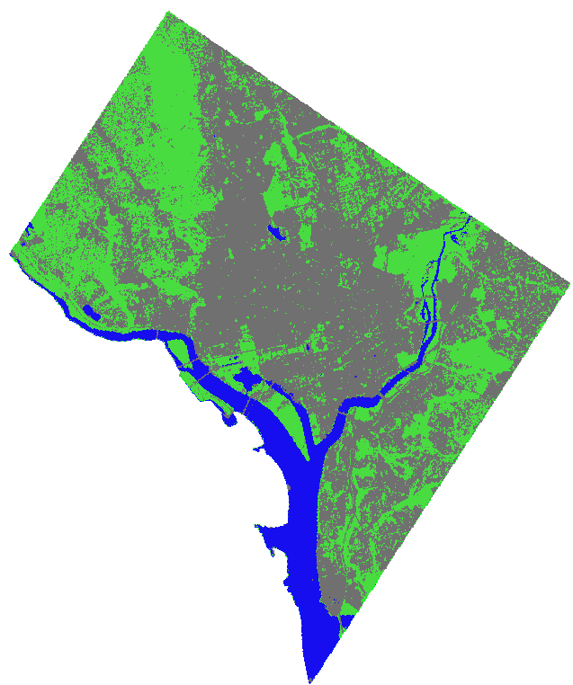
Comparison BTW 10 m and 1 m resolution
Official 1 m × 1 m
Our
10 m × 10 m
Notes:
Here is a compared results from 10-meter and 1-meter resolution images. Higher resolution images give more detailed and accurate results, which are important for urban planning."
https://cicgis.org/portal/apps/webappviewer/index.html?id=bdf7ca3e249a40fd9a9d83d6e16100ea

Slide 17
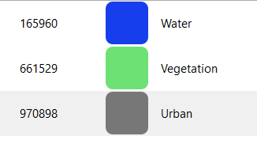
Zonal statistics
Pixel count (r.stats.zonal)
Water = 165960 * (10m*10m) ≈ 16.59 (km)² ≈ 10%
Vegetation = 661529 * (10m*10m) ≈ 66.15 (km)² ≈ 36%
Urban = 970898 * (10m*10m) ≈ 97.08 (km)² ≈ 54%
It is about 179.82 (km)²
Notes:
Zonal statistics performs a summary calculation, such as mean or maximum, for a defined boundary. I used zonal statistics to calculate areas of different land covers. For example, we calculated the area covered by water, vegetation, and urban zones in Washington D.C.“ In total we have about one hundred eighty square kilometers .

Slide 18

Future work
Having more classes
Using complex algorithm(like NN and CNN)
Performing historical data analysis (Ex. from 2017 -2024)
Change detection
Notes:
For the next module, I am going to use more classes, complex algorithm with coding and performing historical data to identify change in the area.

Slide 19



Thank you for your attention
Seyed.peyghambar@mail.polimi.it moein-peyghambarzadeh

